Slide 1
MINOR PROJECT-II
Crime Prediction and Analysis Using Machine Learning
MENTOR NAME: GROUP MEMBERS:
DR. BAJRANG BANSAL ESHA MAHENDRA
HARSHITA MADAN
SHIVANGI GUPTA

Slide 2
INDEX
MOTIVATION
LITERATURE SURVEY
INTRODUCTION TO OUR PROJECT
WORKING MODEL
IMPLEMENTATION
APPLIED ALGORITHMS
ANALYSIS
CONCLUSION

Slide 3
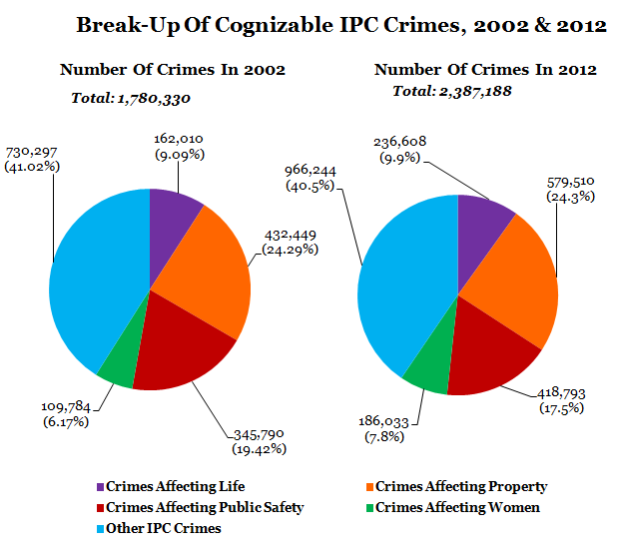
MOTIVATION
Crime: The biggest and dominating problem of society
Keeping track of all the crimes and maintaining database
Understanding crime pattern
Law enforcement by authorities
Pre measures to handle crime rate using analysis
Fig1: IPC CRIMES IN INDIA ^{[3]}

Slide 4
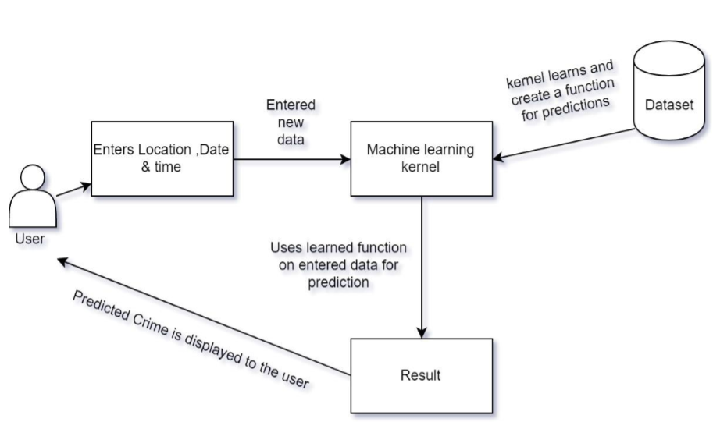
LITERATURE SURVEY
PAASBAAN: Crime prediction and analysis on the basis of latitude, longitude and time for the city Indore.
CHICAGO crime prediction which contains reported criminal activities in the neighborhood of city for duration of 12 years.

Slide 5
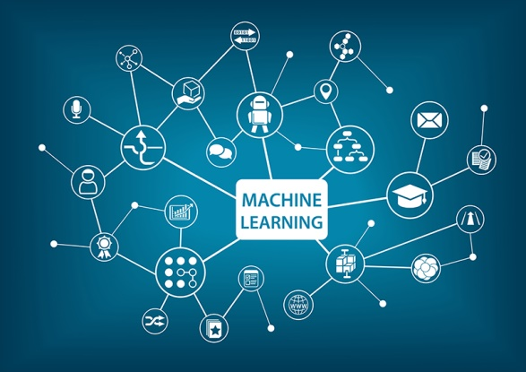
OUR PROJECT
The objective of our project is to analyse dataset ^{[1]} which consist of numerous crimes happened in India(state-wise) from 2001 and predicting the state/ place where crime has happened taking input features as various crimes using MACHINE LEARNING alogrithms.
The objective would be to train a model for prediction. Building the model will be done using better algorithm depending upon the accuracy.

Slide 6
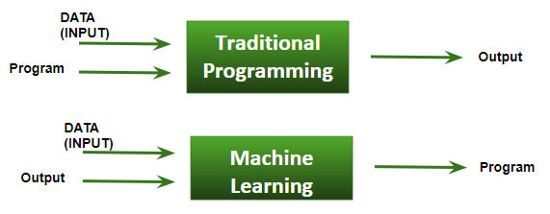
MACHINE LEARNING
Machine Learning is the field of study that gives computers the capability to learn without being explicitly programmed.
As it is evident from the name, it gives the computer that which makes it more similar to humans: the ability to learn.
We need DATA + Output which is run on machine during training and the machine creates its own program (i.e logic), which can be evaluated while testing. This is somewhat different from general programming. ^{[2]}

Slide 7
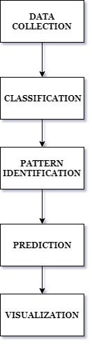
PROPOSED MODEL

Slide 8
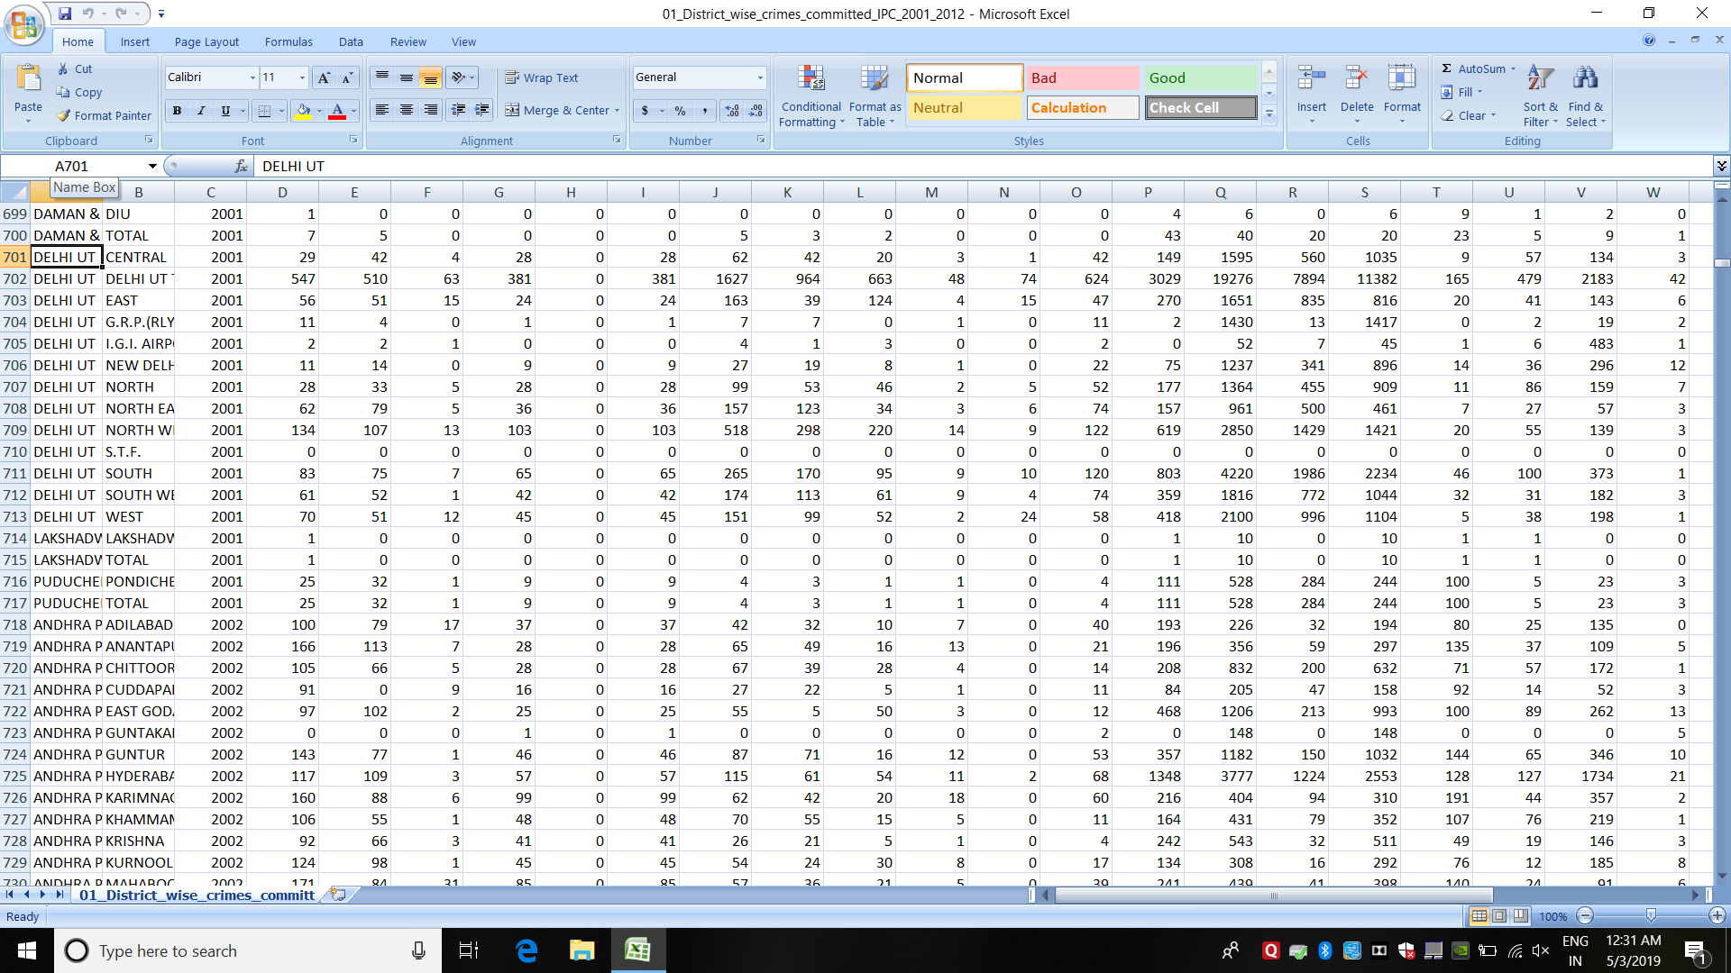
DATA COLLECTION: The dataset for crime rate in India is collected from
Official website that is in CSV(comma-separated values) format which stores
Data in tabular form.

Slide 9
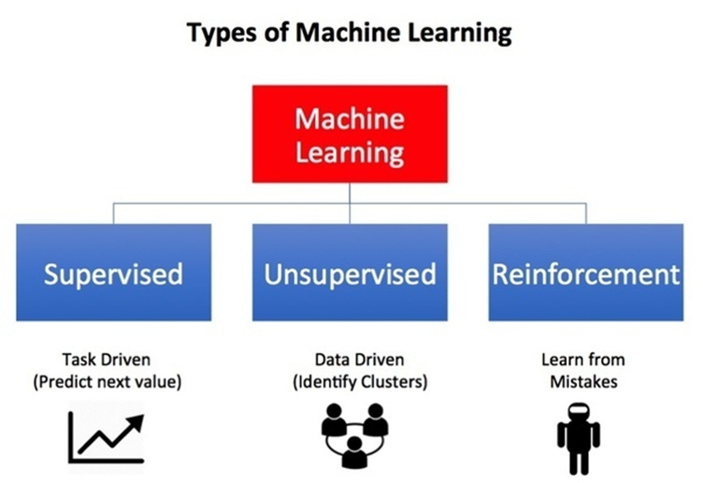
CLASSIFICATION: Based on mainly three categories:
PREDICTIVE MODELING: It is the way of building a model that is capable of making predictions. The process includes a machine learning algorithm that learns certain properties from a training dataset in order to make those predictions.

Slide 10
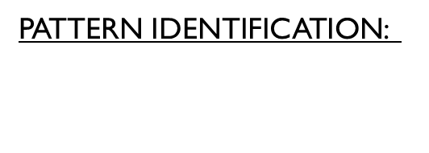
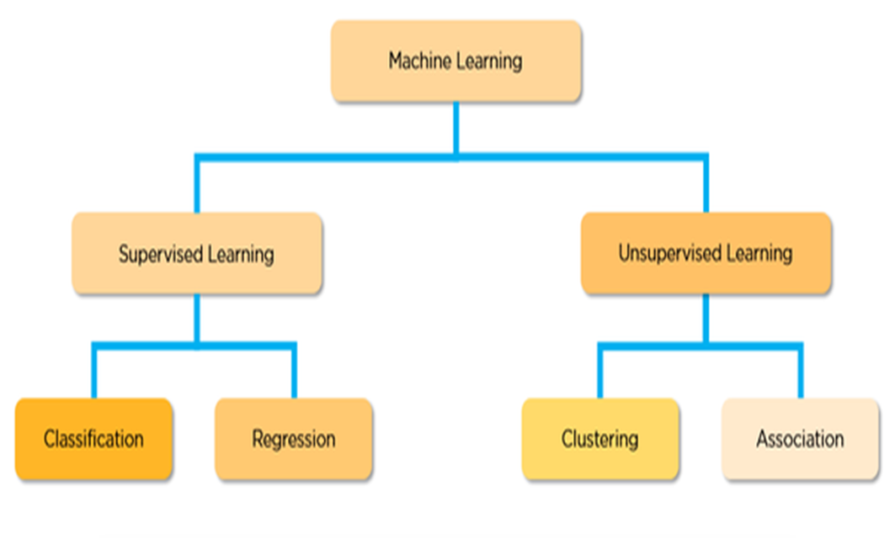
PREDICTION: It is done using various algorithms such linear regression, SVM, decision tree, KNN approach , naïve bayes etc. Algorithms are in Python programming language.
VISUALIZATION: This section deals with the analysis done on the dataset and plotting them into various graphs like bar, pie, scatter. Using mathpoltlib, numpy, pandas libraries, analysis of the crime dataset is done.

Slide 11
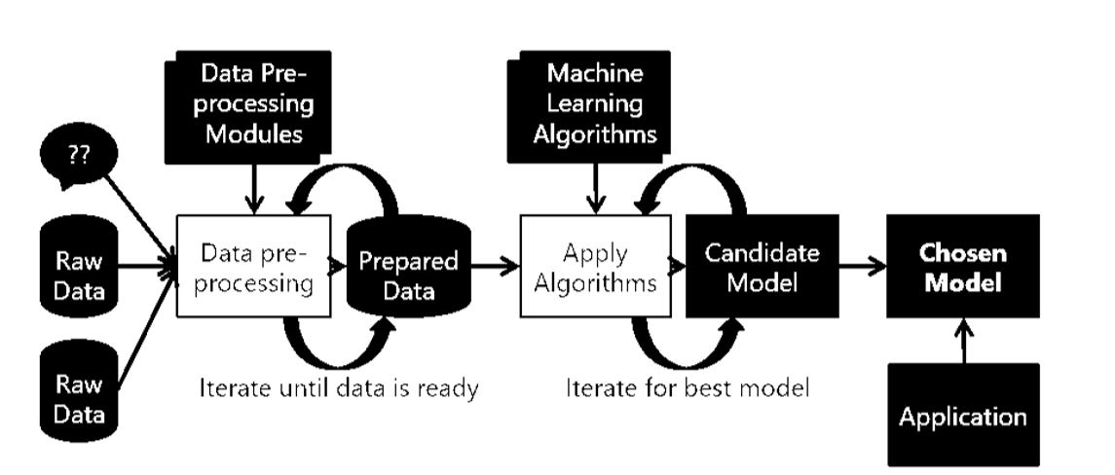
IMPLEMENTATION
DATA PREPROCESSING
10k entries are present in the dataset. The null values or infinite values are removed. The main steps include
Formatting,
cleaning and
sampling

Slide 12
FEATURE SELECTION
Features selection is done which can be used to build the model. The attributes used for feature selection are State, District, area, crime types.
DATA MODELLING
Training Sample: Model will be developed on this sample. 80% of the data goes here.
Test Sample: Model performances will be validated on this sample. 20% of the data goes here.
PREDICTION
After the model is build using the above process, prediction is done using various algorithms and is based on test data . Best Algorithms are chosen on the basis of parameters of prediction and accuracy.
ANALYSIS
Check Model performance - Error, Accuracy, plotting them into various graphs. Confusion Matrix is used to detect the errors and accuracy of the algorithms applied. Analysis done for types of crimes committed over Time, Crimes committed across different location and arrested ratio.

Slide 13
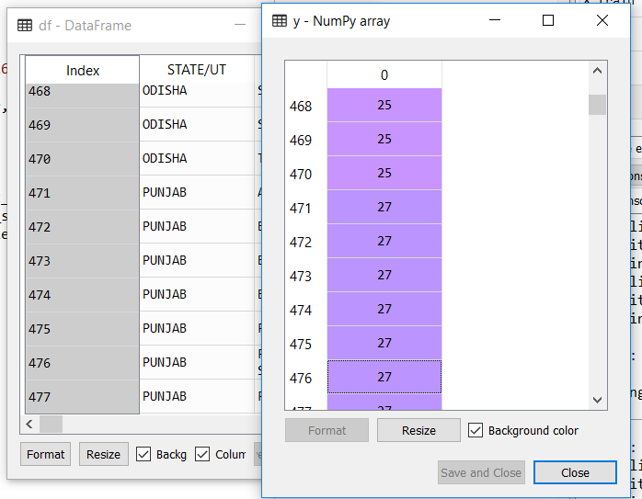
ENCODERS
Our dataset consist of categorical data, so to convert this data into model understandable form, we use label encoder and one hot encoders.

Slide 14
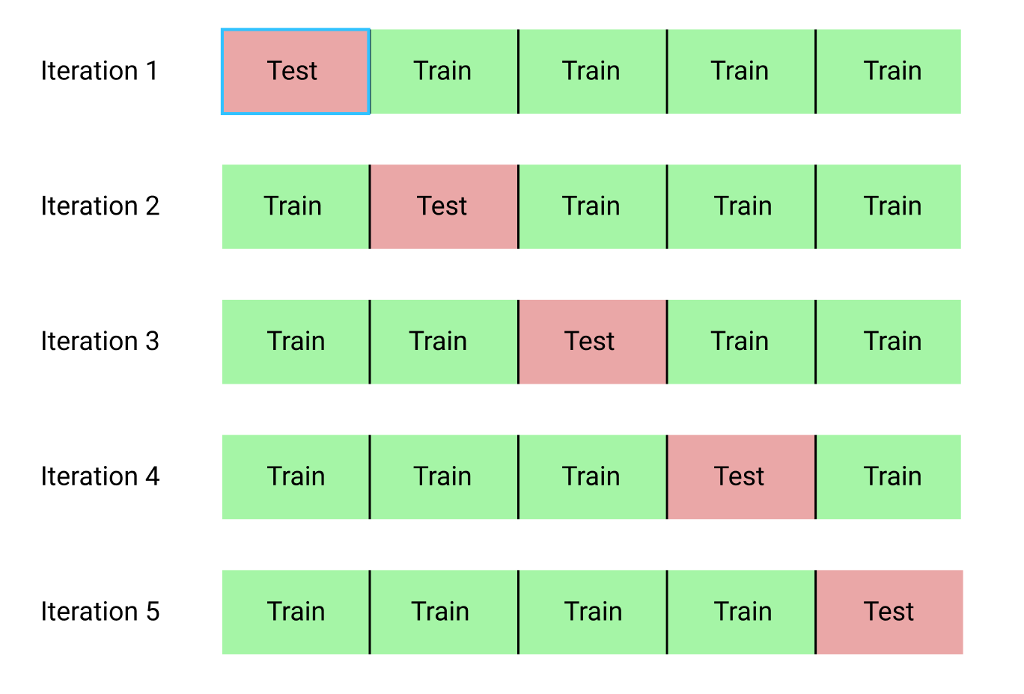
K-fold cross validation
We should train the model on large portion of dataset and should iterate on training and testing process multiple times. ^{[5]}

Slide 15
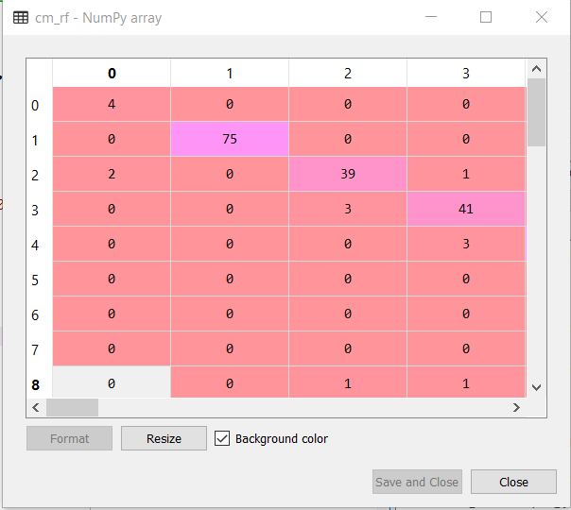
APPLIED ALGORITHMS
KNN algorithm ^{[2]}

Slide 16
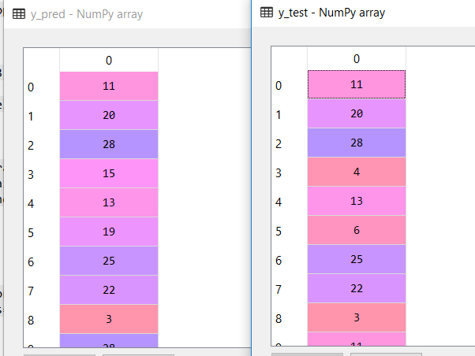
DECISION TREE ALGORITHM ^{[5]} : It is a tree which helps us by assisting us in decision-making. Used for both classification and regression, it is a very basic and important predictive learning algorithm. It is different from others because it works intuitively i.e., taking decisions one-by-one.

Slide 17
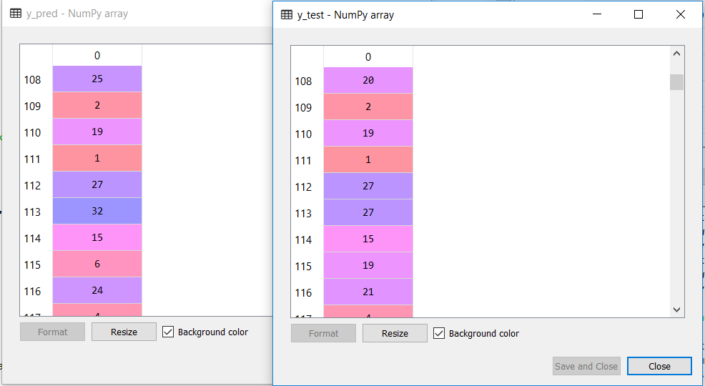
SUPPORT VECTOR MACHINE ^{[5]}: Support Vector Machine (SVM) is a supervised machine learning algorithm which can be used for both classification or regression challenges. It is mostly used in classification problems. In this algorithm, we plot each data item as a point in n-dimensional space with the value of each feature being the value of a particular coordinate.

Slide 18
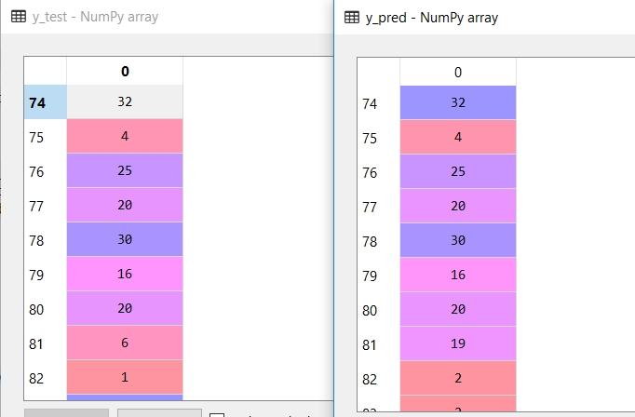
LINEAR REGRESSION: Linear Regression is a machine learning algorithm based on supervised learning. It performs a regression task. Regression models a target prediction value based on independent variables. It is mostly used for finding out the relationship between variables and forecasting.

Slide 19
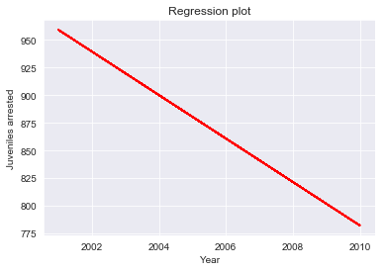
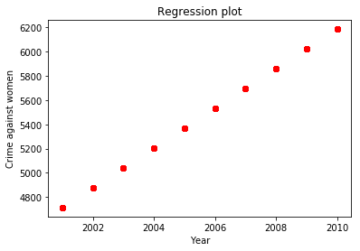
ANALYSIS
These are the plots obtained after applying regression .These plots shows how the crimes done by juveniles and crimes against women varied with year.

Slide 20
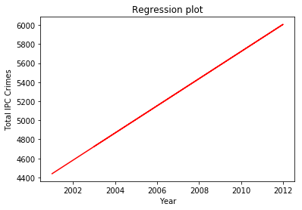
ALGORITHMS ACCURACIES
K NEAREST NEIGHBOURS | 86.5388816850331
SUPPORT VECTOR MACHINE | 75.05543237250555
NAÏVE BAYES | 12.250554323725056
DECISION TREE | 72.11751662971175

Slide 21
CONCLUSION
With the help of this project, it has become easier to detect crime pattern.
We got deep understanding of machine learning and its various algorithms.
Further we can work more on this project and predict crime for future years. Moreover, we can develop a software regarding this project.

Slide 22
REFERENCES
https://www.kaggle.com
https://www.geeksforgeeks.com
https://www.google.co.in/images
Alkesh Bharati, Dr. Sarvanaguru R.A.K (Sep 2018), “Crime prediction analysis using machine learning” , IRJET, Volume: 05 Issue: 09 | Sep 2018 (Research paper)
https://www.machinelearningmastery.com

Slide 23
THANK YOU!

